Slide 1

Heat
WELCOME!

Slide 2
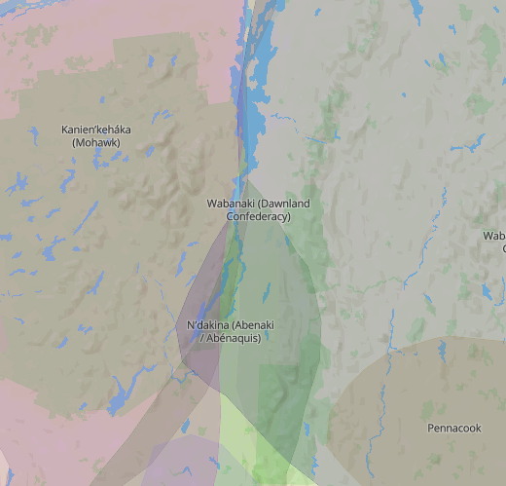
Land Acknowledgement
Notes:
From https://native-land.ca/

Slide 3
Thank you to:
Kim Hornung-Marcy
Gene Kraus
Cheryl Joy-Lipton
Geetu Melwani
Debbie New
Scot Zens
For developing this presentation
Notes:
From https://native-land.ca/

Slide 4
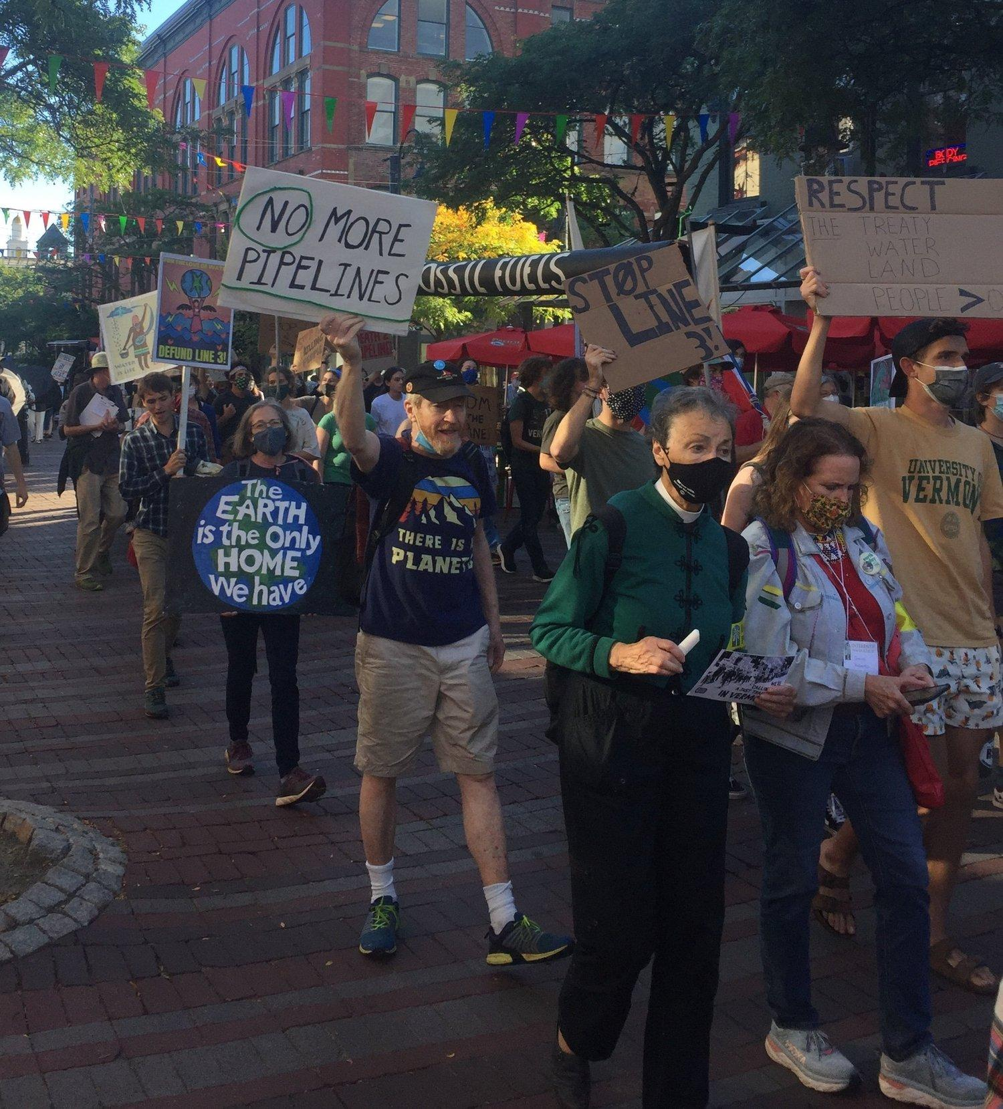
350VT’s Mission
350VT is building a people-powered and people-led climate justice movement in Vermont for a just, thriving world.
We are guided by the voices, experiences, and solutions of those most impacted by the global climate crisis. We strive to work at the intersections of the climate crisis and social justice to address the climate crisis equitably and effectively.
We are building collective power for climate justice.

Slide 5
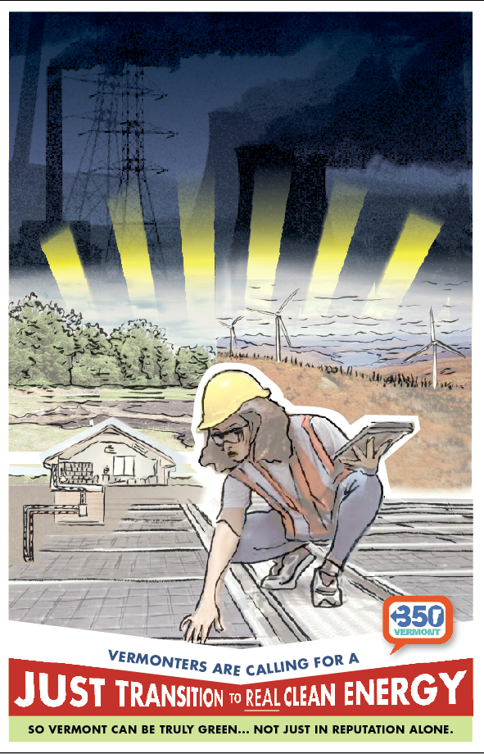
Agenda
Introductions
Pair Share
Heating & Cooling in VT: Where it Comes From 101, Why it Matters & What We Want
Q & A
Reactions/More Questions
What can we do about it?
Final Pair Share
Next Steps
Closing

Slide 6
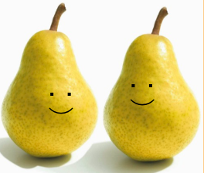
Pair Share
What brought you to this workshop?
What’s the connection between electricity and climate change?
Name, Pronouns, Town

Slide 7
Thermal Quiz
How does Vermont heat and cool it’s buildings?
a.
b.
c.
d.

Slide 8
Thermal Quiz
How polluting is each of these sources?
a.
b.
c.
d.

Slide 9
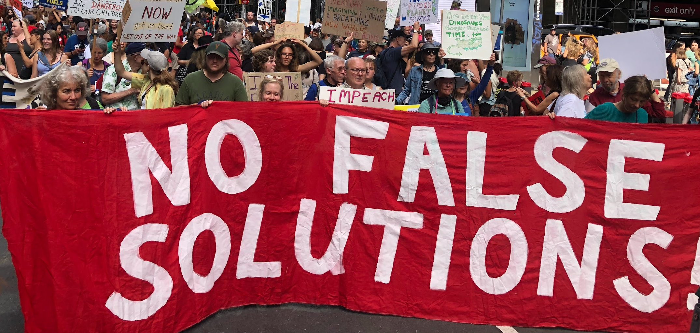
Heating & Cooling in VT 101:
Why it Matters, Where it Comes From, & What We Want

Slide 10
The Sticky Note Chat Room

Slide 11
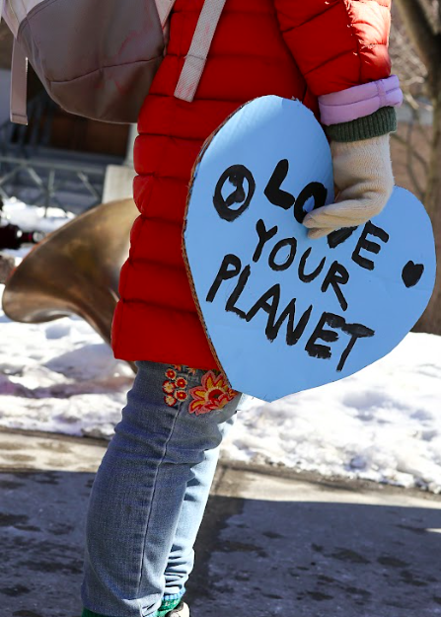
Framing the Conversation
Today we will largely talk about our thermal policy in VT, its pitfalls, and what we want to see change to ensure our electricity is truly green and just.
But we also need to remember that there is no 100% perfect energy generation solution
which means
we ultimately need to reduce our use of heating & cooling sources.
Feb 2023 Rally at the VT Statehouse

Slide 12
Why heating and cooling matters
Many proposed climate solutions involve transitioning to electric methods of heating and transportation, dramatically increasing our electricity use.
…But electrifying only reduces emissions if the electricity sources are truly low emissions. How we heat and cool our buildings will have an impact on much electricity we need to produce.

Slide 13
What is the Affordable Heat Act?
This is a law passed in 2023, that requires gas utilities and fuel-dealers to gradually their use of fossil fuels every year.
Sounds great!
…right?

Slide 14
Three major problems with the AHA:
What is considered renewable.
It allows utilities to meet their clean-energy obligations by purchasing clean energy credits while providing non-renewable energy.
It disincentivizes adoption of cleaner, affordable heating through weatherization, electrification, geothermal, and thermal energy networks.

Slide 15
Biomass is considered
Renewable Energy
Problem #1

Slide 16
What data has informed 350VT’s understanding and position
Presentations and testimony of biomass experts at the McNeil Symposium, to the Burlington City Council, and to the Vermont Senate Environment and Energy Committee
Laura Haight, U.S. Policy Directory, Partnership for Policy Integrity, April 24, 2023
Bill Moomaw, Professor Emeritus of International Environmental Policy at the Fletcher School, Tufts University
Dr. Juliette Rooney-Varga, Ph.D. - Professor, Director - Climate Change Initiative University of UMass Lowell
Also EPA carbon an air quality data, biomass research, memos from Burlington Electric and VEIC, and Bill McKibben, Founder of 350.org and Third Act
This data has been reviewed, analyzed and synthesized by unpaid and committed volunteers from Stop Vermont Biomass and 350VT to support our elected officials to make the right energy choice on behalf of their constituents.
All materials we have consulted can be found here. Here is the one page overview of our analysis.

Slide 17
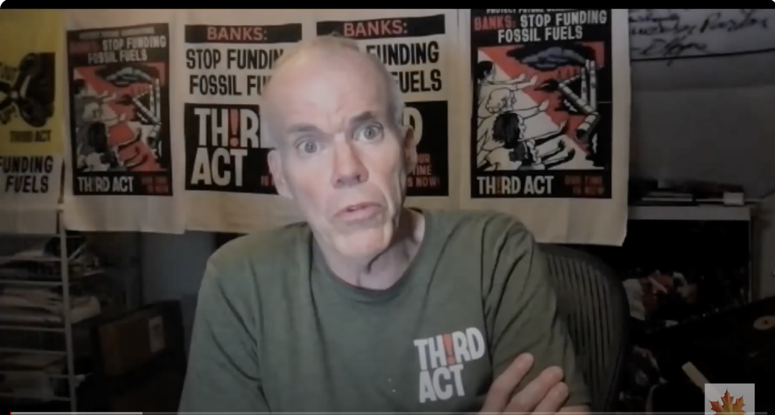
Bill McKibben on Biomass
FiB
https://www.youtube.com/watch?v=vMtRVm8G5mc

Slide 18
Biomass pollution is comparable
to oil, coal and gas

Slide 19
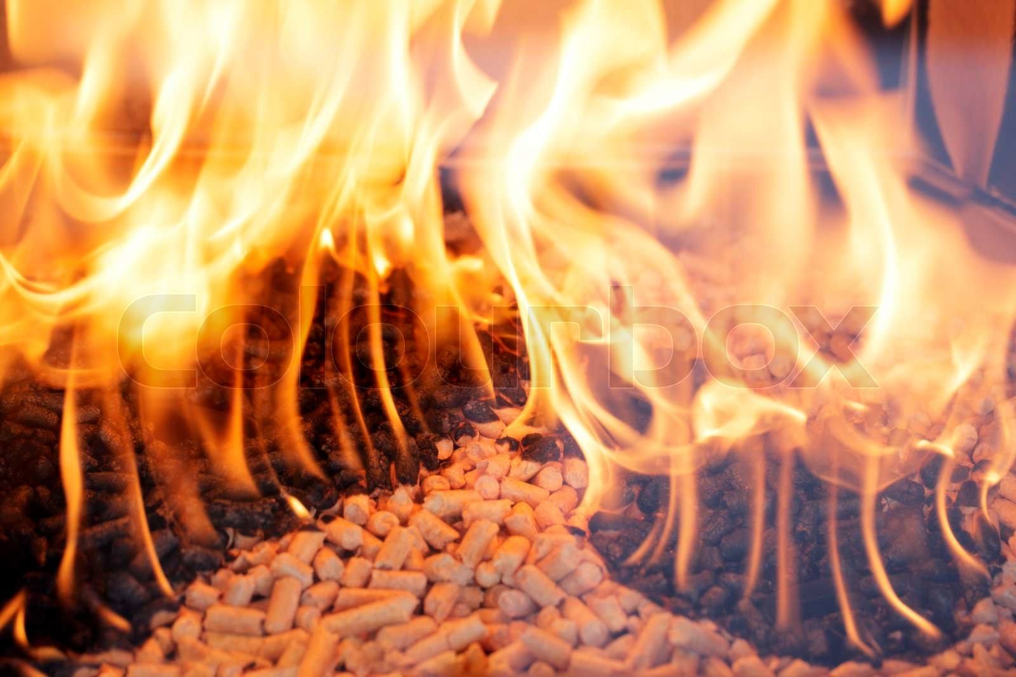
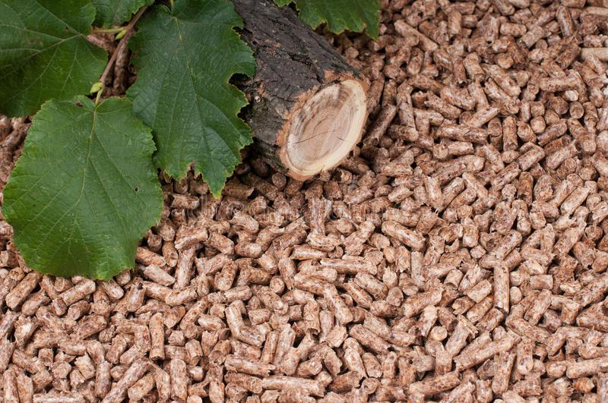
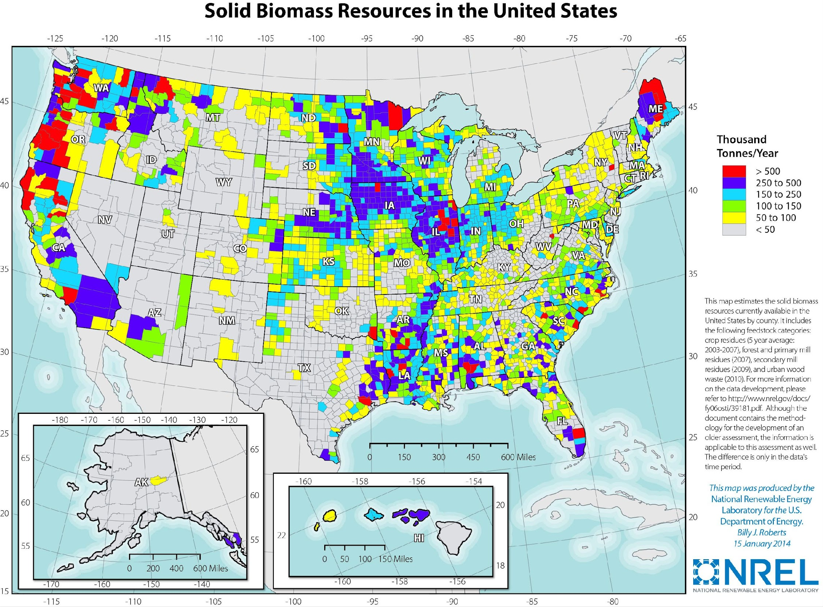
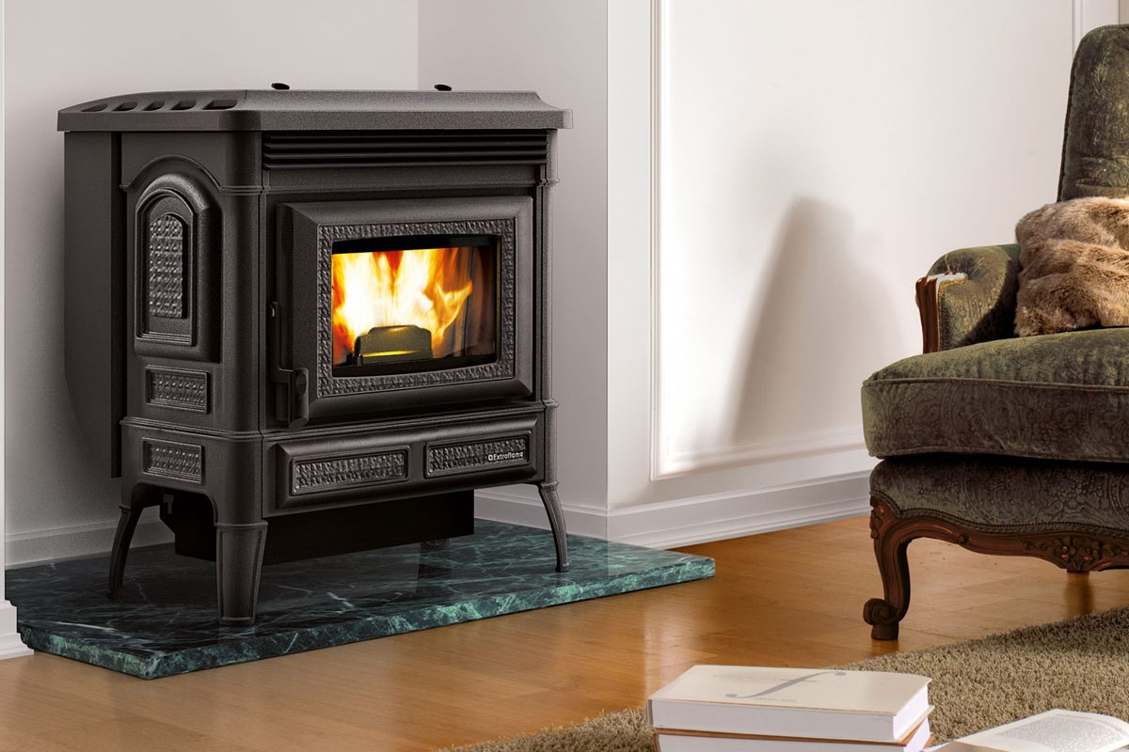
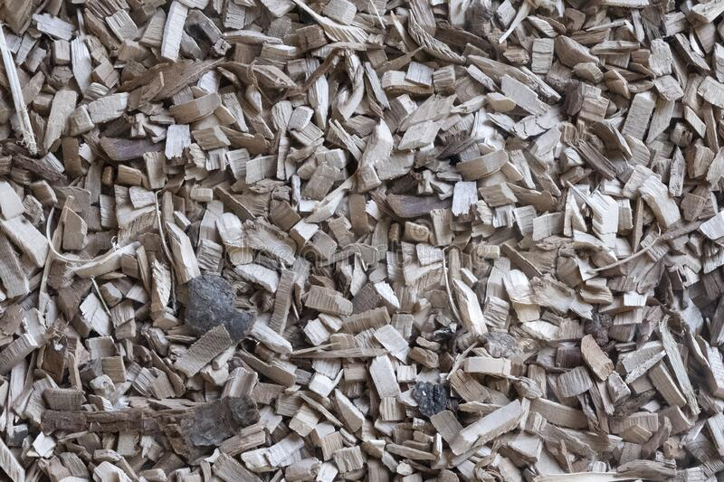
Let’s take a closer look: Solid Biomass
To make a meaningful difference it would take a lot of solid biomass.
Biomass would have to travel a far distance OR we would devastate our own landscapes.
Combustion
Pellets
Burning appliances
Wood Chips
Notes:
Scot: Using biomass as a fuel source can have wide reaching impacts well beyond the borders of our State.

Slide 20
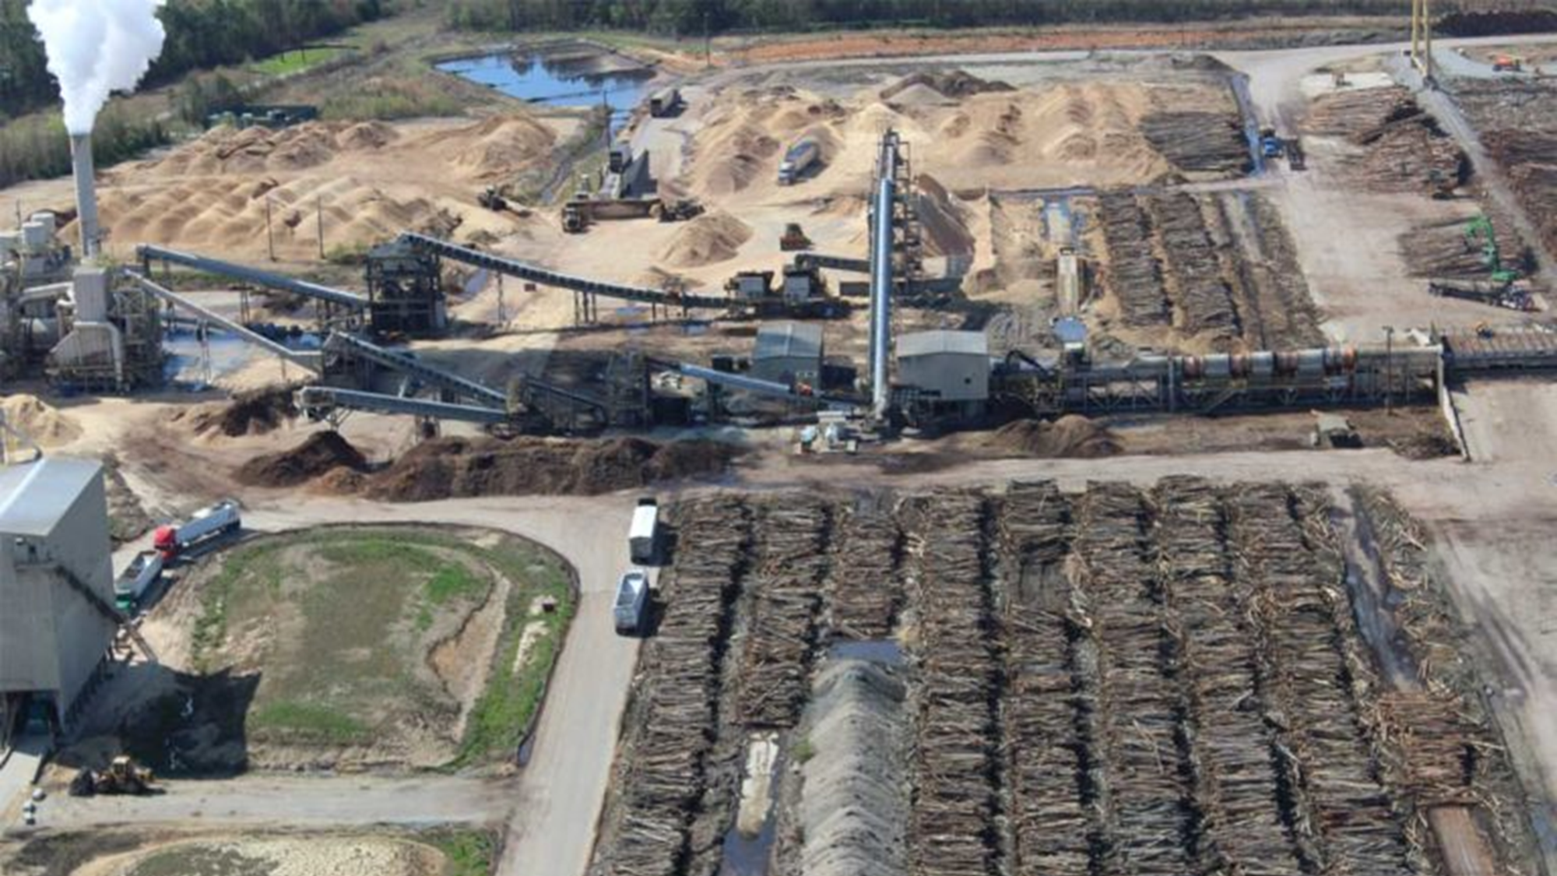
Life Cycle Analysis: Solid Biomass
500+ scientists wrote:
“Overall, for each kilowatt hour of heat … produced, using wood initially is likely to add two to three times as much carbon to the air as using fossil fuels.” Raven et al. 2021
Notes:
Scot

Slide 21
Here’s what the science says
"Burning wood is also carbon-inefficient, so the wood burned for energy emits more carbon up smokestacks than using fossil fuels. Overall, for each kilowatt hour of heat or electricity produced, using wood initially is likely to add two to three times as much carbon to the air as using fossil fuels.”
"Government subsidies for burning wood create a double climate problem because this false solution is replacing real carbon reductions. Companies are shifting fossil energy use to wood, which increases warming, as a substitute for shifting to solar and wind, which would truly decrease warming.”
Letter Regarding Use of Forests for Bioenergy: Letter to Biden from over 1,000 top world scientist asking no more net-zero for wood.
“Burning wood to generate electricity emits more carbon dioxide per kilowatt-hour generated than fossil fuels- even coal, the most carbon intensive fuel.”
John Sterman, William Moomaw, Juliette N. Rooney-Varga & Lori Siegel, Does wood bioenergy help or harm the climate?, Bulletin of the Atomic Scientists, Vol 78, No. 3 (2022) 130.

Slide 22
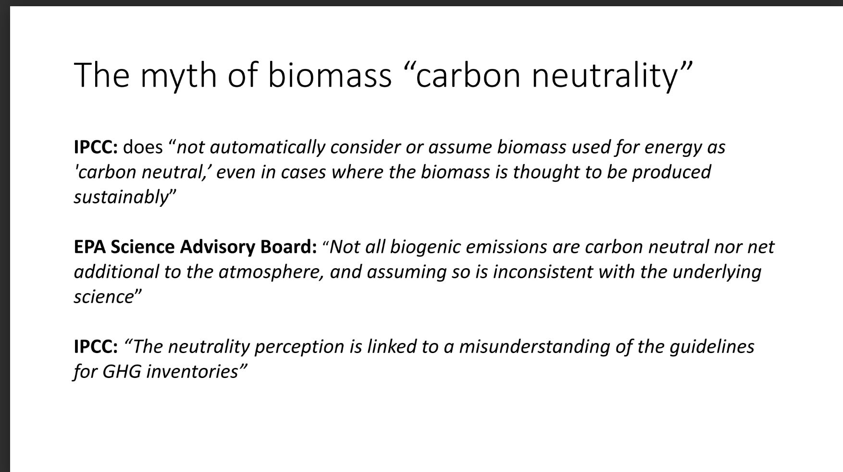

Slide 23
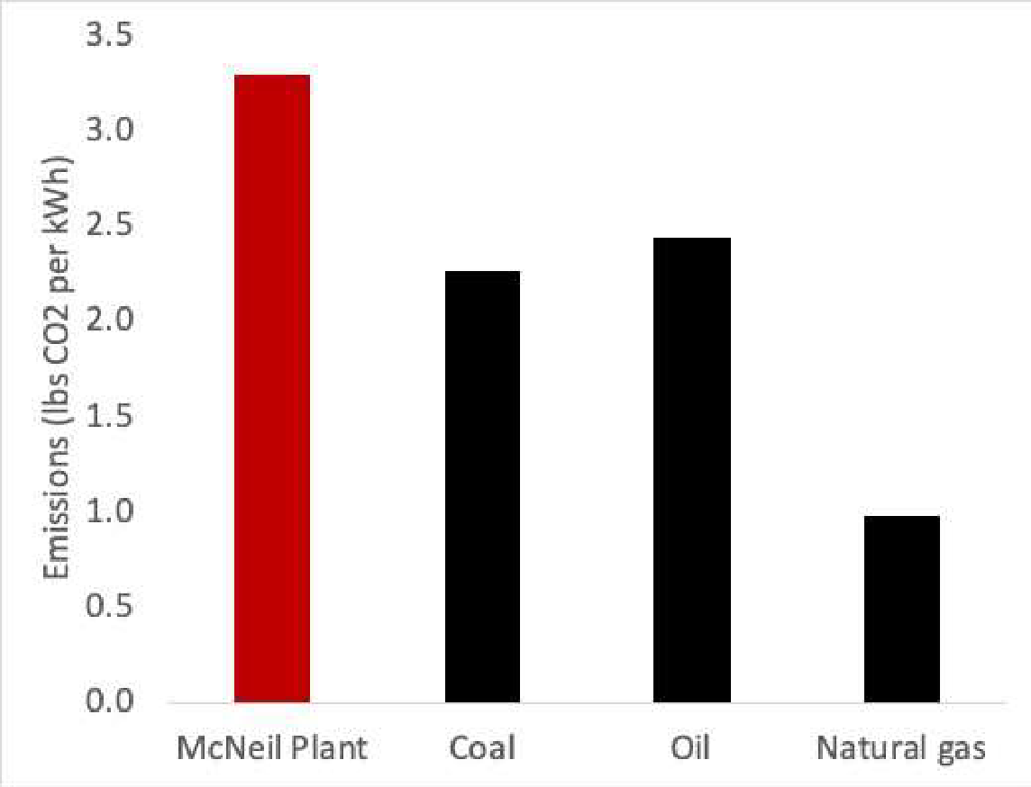
Vargas, Moomaw, Zakaras June 2023
Burning wood biofuels emits more carbon dioxide per kilowatt-hour generated than fossil fuels— even more than coal, the most carbon-intensive fossil fuel.
Carbon emissions from the wood supply chain also exceed those from coal because wood must be harvested, chipped, and transported again to a power plant.
In 2022, … 375,540 short tons of CO2 from biomass and 537 short tons from the plant’s fossil fuel operations to produce 228,981 MWh of electricity, or 3.3 lbs CO2 per kWh—significantly higher than electricity from coal and more than three times higher than electricity from natural gas.
The steam pipeline expansion, not shown here, would add approximately 14,000 tons of CO2 per year to total emissions.
Sources: U.S. Energy Information Administration
https://www.eia.gov/tools/faqs/faq.php?id=74&t=11 and 2023 Final Report on
McNeil Forestry and Carbon Emissions and Sequestration
https://www.burlingtonelectric.com/wp-content/uploads/McNeil-Carbon-6.2023.pdf
2 For additional reading on this subject, see Michael Norton, et al, Serious mismatches continue between science and
policy in forest bioenergy, Bioenergy, Vol. 1, Issue 11, Nov. 2019, 1253-1391; Sterman, J., et al. Does wood bioenergy
help or harm the climate? Bulletin of the Atomic Scientists 78, 128-138 (2022); Sterman, J., et al, Does replacing coal with
wood lower CO2 emissions? Dynamic lifecycle analysis of wood bioenergy. Environ Res Lett 13 (2018). See also this
letter to the EU Parliament signed by 800 scientists in 2018:
https://searchinger.princeton.edu/sites/g/files/toruqf4701/files/letter_of_scientists_european_parliament_on_use_of_forest
_biomass_for_bioenergy_january_14_2018.pdf

Slide 24
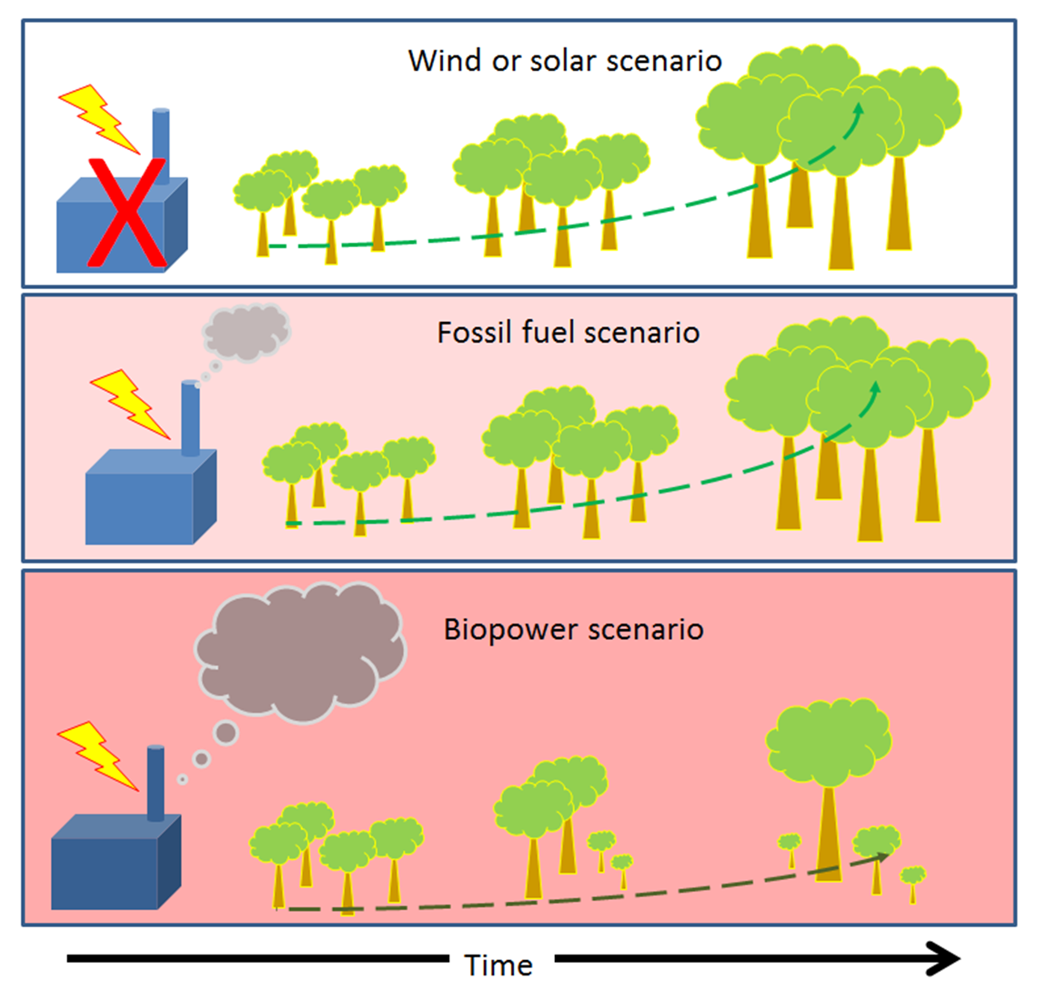
Wood burning power
plants emit more CO₂
per unit energy and also
degrade the forest
carbon sink.
The result is higher
atmospheric CO₂
concentrations.

Slide 25
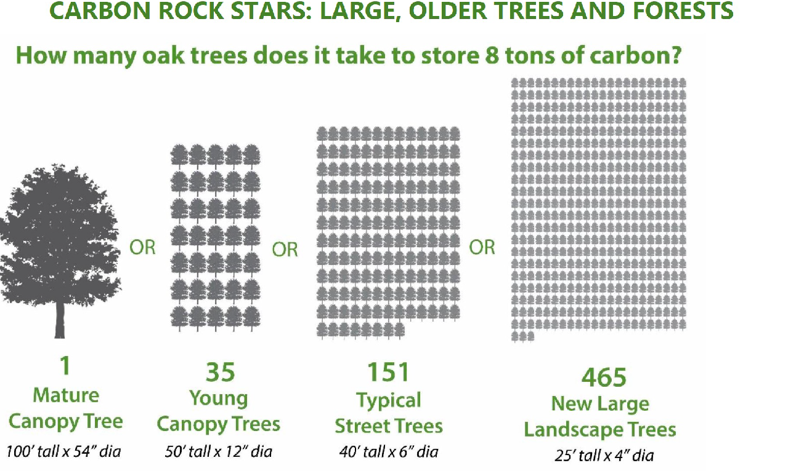
A large tree stores more carbon than many smaller ones

Slide 26
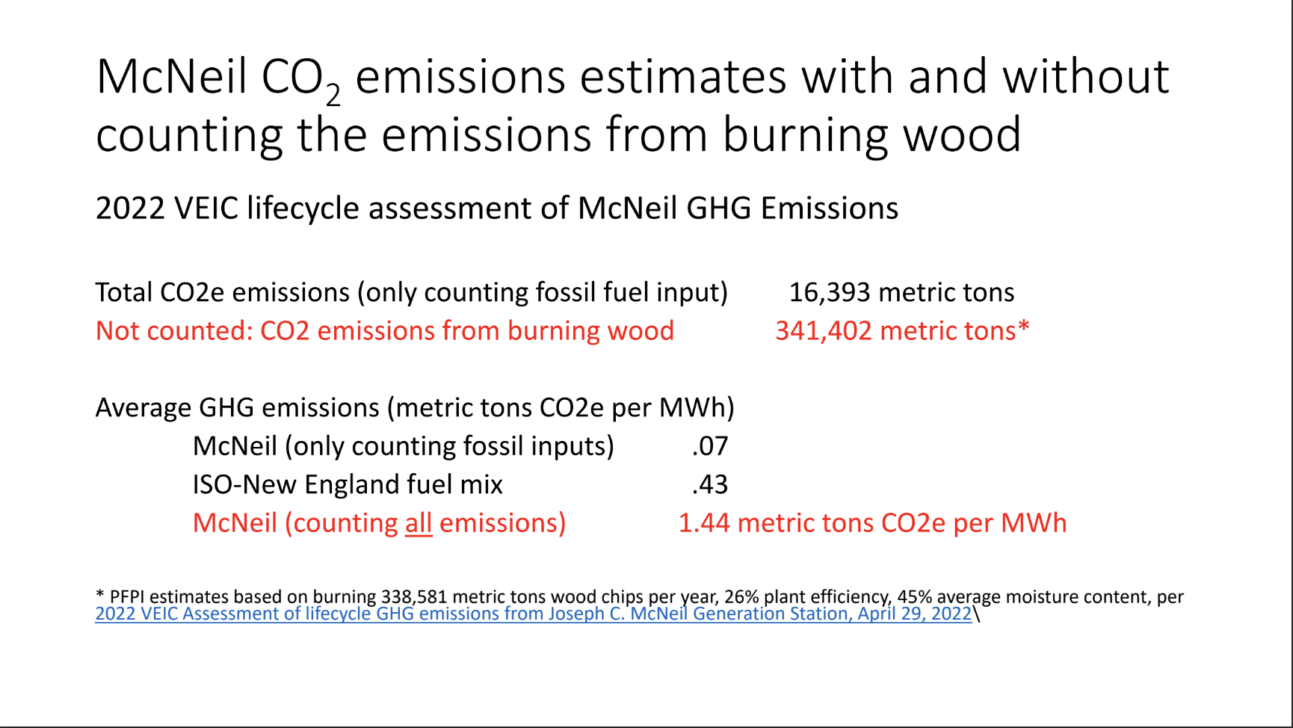
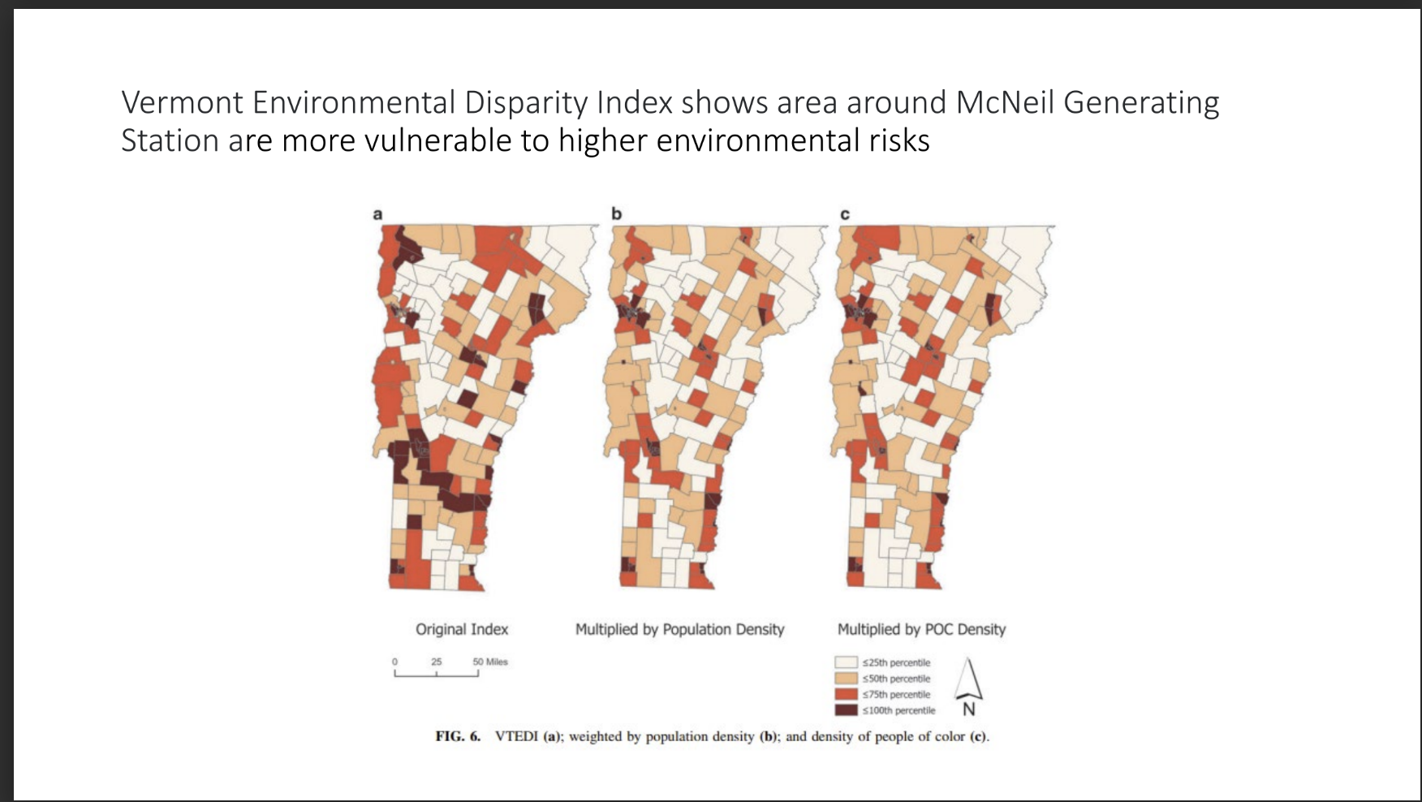
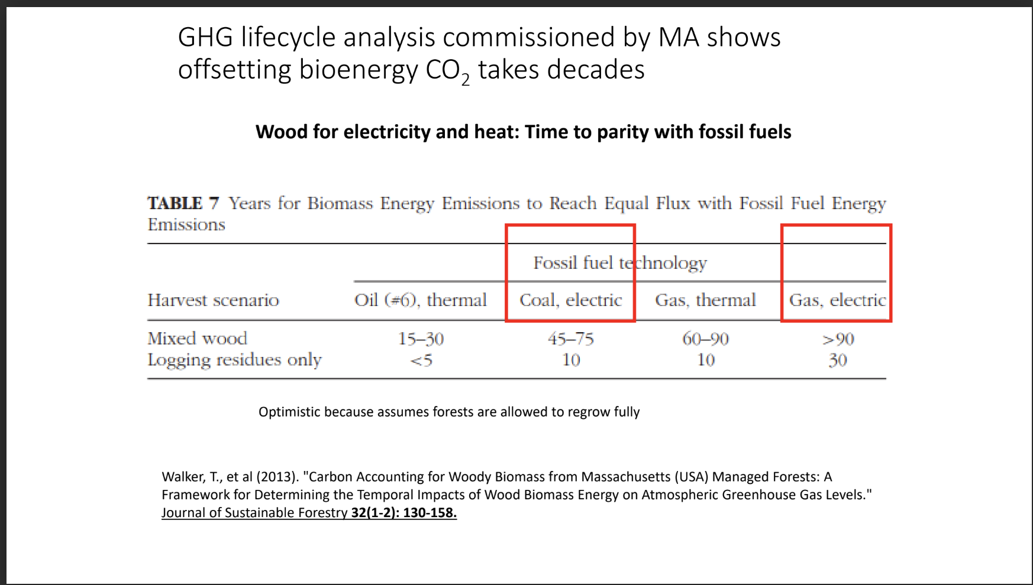
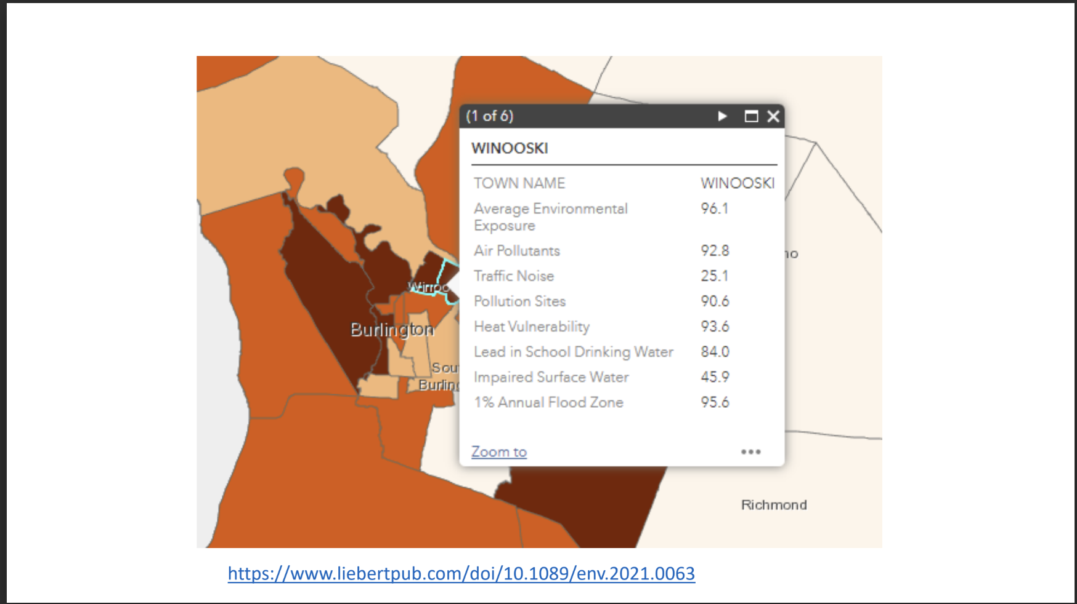
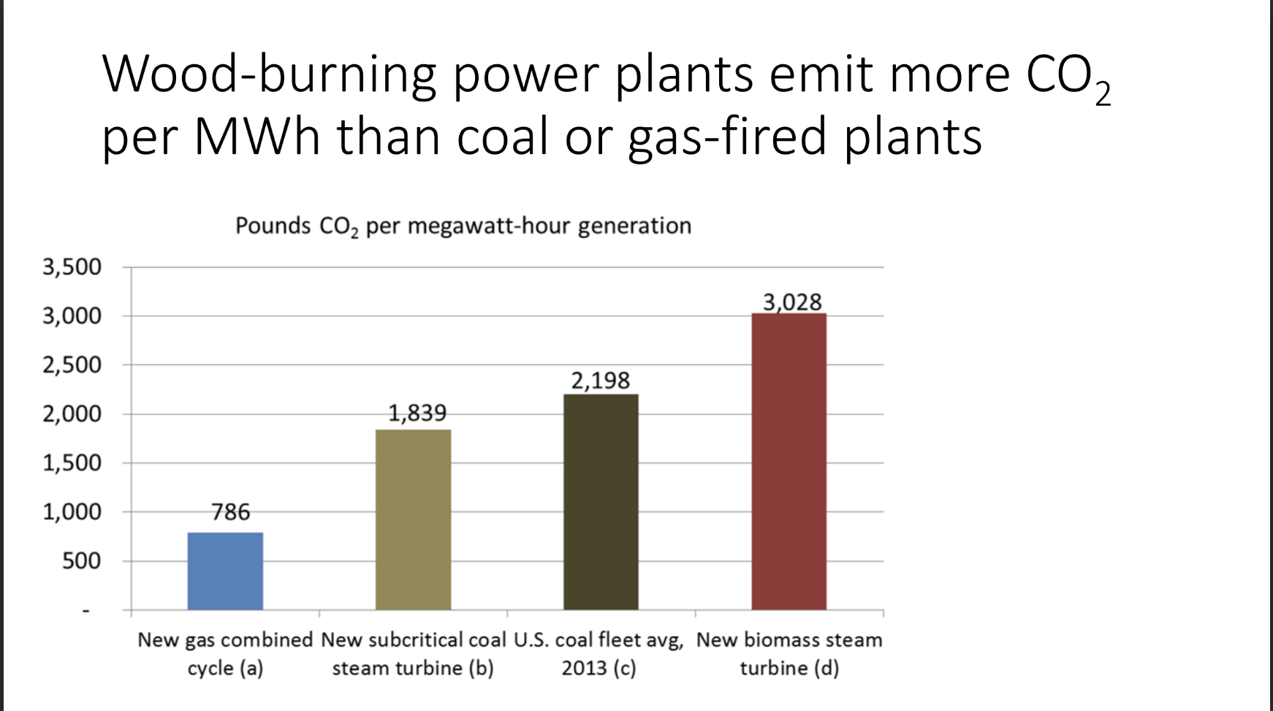
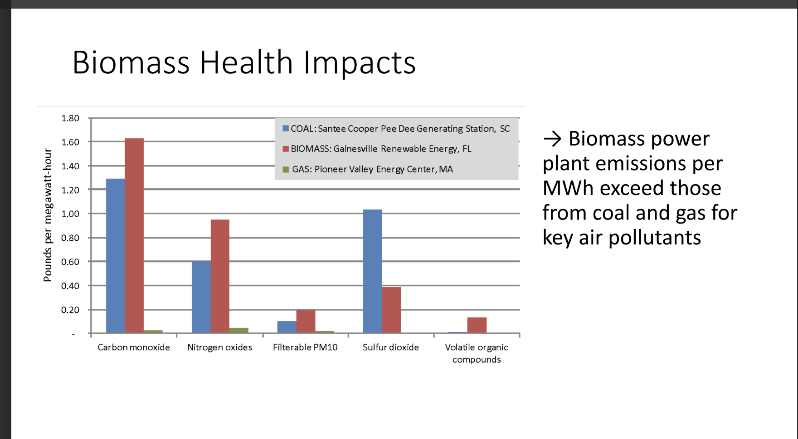
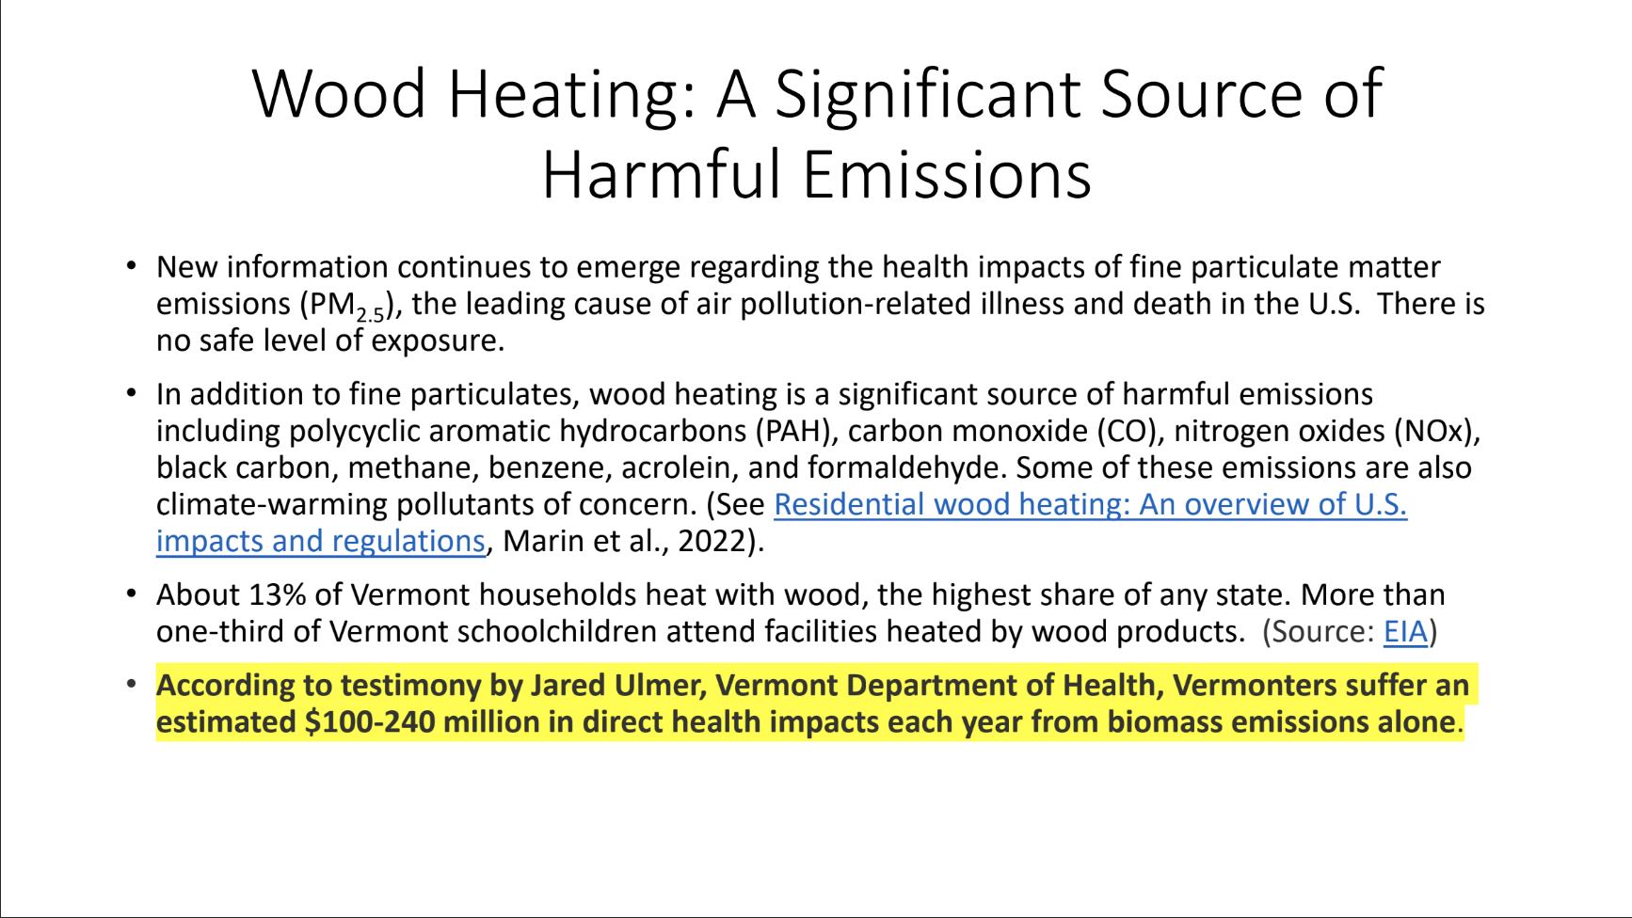
Laura Haight, PPI
Testimony to VT Senate Environment & Energy Committee
April 24, 2023

Slide 27
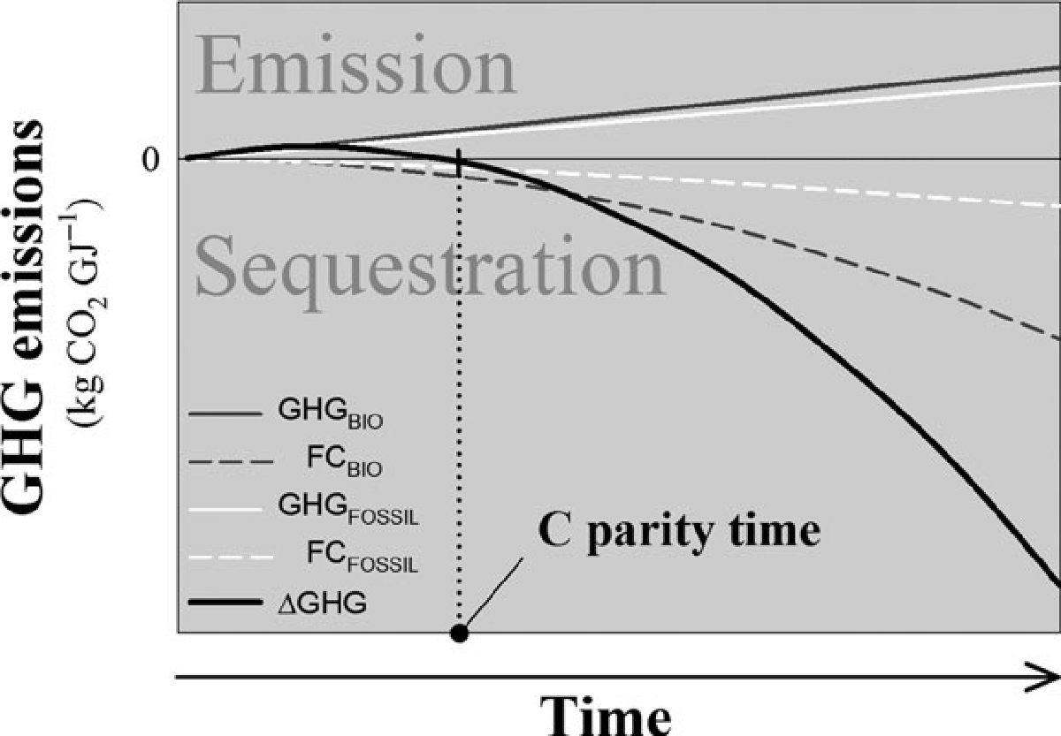
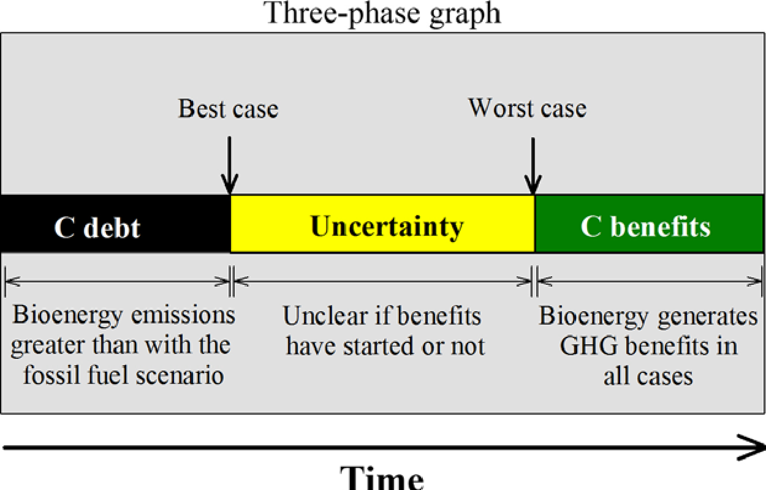
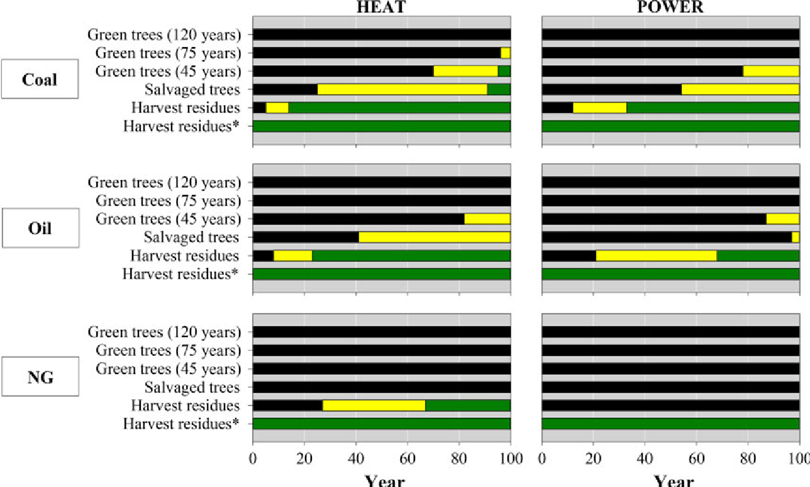
Laganiere et al. 2017
Biomass produces much more GHG than NG, Oil and even Coal.
Over 100 years from the time a stand is harvested, sequestration does not come close to making up for the emissions.

Slide 29
Rooney-Varga & Moomaw Policy Recommendations
For Vermont:
Discontinue policies that treat wood bioenergy as carbon neutral. The carbon emitted from wood should be counted the same way that emissions from other fuels are—fully, at the point of combustion.
End subsidies for wood bioenergy. Taxpayers and ratepayers should not be paying pellet, woodchip, and power producers to make climate change worse.
Encourage transition to clean energy—solar, wind, and thermal.
Offer incentives to private landowners to preserve forests for long-termaccumulation of carbon.
Offer incentives for using low-grade trees and harvest residues in long-lived products that are not burned, such as oriented strand board and cellulose insulation.
For your location:
Avoid investment in biomass plant and transition to clean energy.
Reduce forest harvesting and promote greater forest carbon reserves.
Juliette N. Rooney-Varga, William Moomaw, and Laura Zakaras, Is Burning Wood Climate Neutral?, RIST Institute for Sustainability & Energy, Umass Lowell,

Slide 30
The McNeil Biomass Plant is Vermont's biggest CO2 emitter
Electric generating Facility - Reporting year 2021 | Plant primary fuel category |  | Plant annual unadjusted CO2e equivalent emissions (tons) **, ***
J C McNeil - Burlington Electric | BIOMASS |  | 462,787
Coventry Clean Energy Corp – Wash. Elec. Coop - (VT) | BIOMASS |  | 35,962
Middlebury College – Middlebury Biomass | BIOMASS |  | 24,671
Moretown - EPP Renewable Energy | BIOMASS |  | 4,989
Berlin 5 - GMP | OIL |  | 2,410
Penny Lane Gas Turbine - Burlington Electric | OIL |  | 659
Ascutney - GMP | OIL |  | 638
VPPSA Project 10 - VT Public Power Supply | OIL |  | 594
Rutland - GMP | OIL |  | 439
Colchester 16 - GMP | OIL |  | 382
Source: https://www.epa.gov/power-sector/power-sector-emissions-data * Converted to same units ** Includes CO2, CH4 x 25, N2O x 298 ; follows the protocol and conversions from IPCC AR4 *** CO2 and CH4 grossly underestimated compared to full life cycle emissions

Slide 31
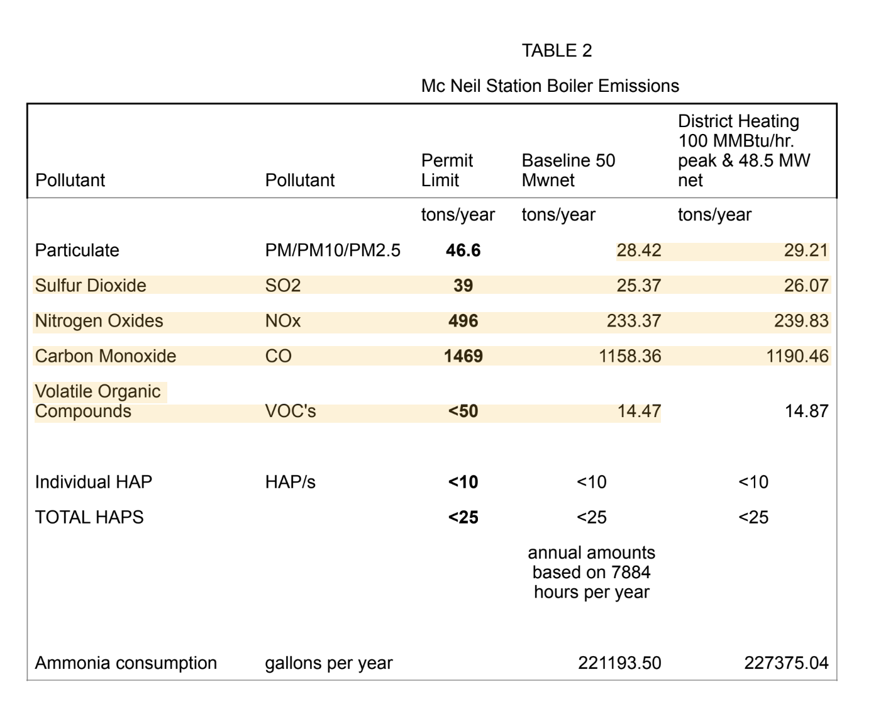
McNeil District Heating Makes More Pollution Per Unit of Energy
The McNeil expansion will change the combustion equipment so that there are increases in:
Greenhouse Gases
Particulates
Ammonia
Drivers of acid rain
per unit of energy produced.
Yanke Energy Report 2018 - Shultz and Roskins

